Slide 1
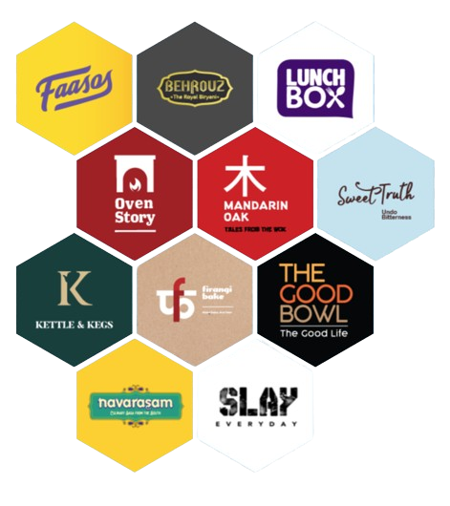
REBEL FOODS
BUSINESS
CASE STUDY

Slide 2
Overview
FOUNDING DATE
FOUNDERS
HEADQUARTERS
October 2011
Jaydeep Barman & Kallol Banerjee
Mumbai, India
Business Model
Cloud Kitchen: Rebel Foods operates a cloud kitchen model, where multiple brands are run out of a single kitchen space
Multiple Brands: They manage a portfolio of various food brands, each catering to different tastes and preferences, and leverage technology for efficient operations

Slide 3



Key Business Chains
1
Behrouz Biryani
2
Oven Story Pizza
3
Faasos
4
Nature’s Basket
Specializes in biryani and other traditional Indian dishes
Focuses on pizza, including a range of unique and classic flavors
Offers a diverse menu including wraps, rolls, and other fast-food items
Focuses on providing gourmet and premium food products
5
The Good Bowl
6
LunchBox
7
Sweetstuff
8
Biryani By Kilo
Specializes in bowls with a variety of healthy and gourmet ingredients
Offers a range of Indian and international meal options
Provides a range of desserts and sweet treats
Specializes in biryani and offers both traditional and innovative variations
Key Details
REVENUE - 2024
NUMBER OF KITCHENS
POTENTIAL COMPETITORS
NUMBER OF BRANDS
₹1,300+ crores
400+
Swiggy, Zomato, Fresh Menu etc..
10+

Slide 4



PORTER's 5 forces
1
Competitive Rivalry
4
Bargaining Power of Customers
Presence of many players in the market
High
High
Customers have many food delivery options and can easily switch between brands
2
Threat of New Entrants
Relatively high due to lower capital requirements
High
5
Threat of Substitutes
3
Bargaining Power of Suppliers
Moderate
Customers might opt for substitutes based on price, quality, or health trends
Moderate
Has some bargaining power but is still subject to fluctuations in supplier terms and prices

Slide 5
PESTLE
Political :
Subject to food safety regulations and labor laws
2. Economic :
Increasing urbanization leads to growing food delivery
3. Social :
Increased focus on health and wellness affects menu offerings
4. Technological :
Reliance on mobile apps and online platforms for order and delivery management will bring a dominant change
5. Legal :
Must comply with food safety laws, labor regulations, and consumer protection laws
6. Environmental :
Increasing focus on eco-friendly packaging and waste management practices

Slide 6

S
W
SWOT ANALYSIS
STRENGTHS
WEAKNESSES
Diverse Brand Portfolio
Cloud Kitchen Model
Technology Integration
Dependence on Delivery Partners
Brand Overlap
Operational Complexity
O
T
OPPORTUNITIES
THREATS
Market Expansion
Product Innovation
Collaborations
Intense Competition
Economic Fluctuations
Regulatory Changes

Slide 7
Six Forces Model
Complementary Products and Services
Moderate
Influence: Related services like online payment platforms, delivery aggregators, and packaging suppliers play a role in Rebel Foods’ operations.
Impact: Collaborations with these complementary services can enhance operational efficiency and customer experience, but reliance on them also introduces risks.

Slide 8
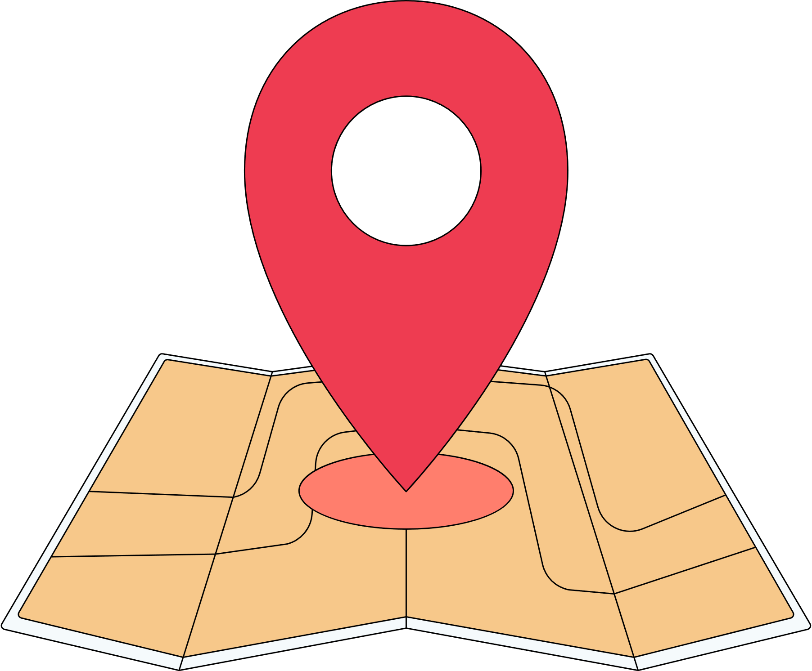



GAP Analysis
Geographical Reach
Brand Saturation
Limited presence outside major urban centers
Overlapping brand offerings might dilute the market
Revenue Targets
Operational Efficiency
Potential over-reliance on third-party delivery partners
Need to continuously innovate and expand to meet ambitious revenue growth targets

Slide 9



3P’s Analysis
People
Process
Product
Skilled and motivated workforce
Strong leadership team
Efficient cloud kitchen operations
Advanced technology and a well-managed supply chain
Diverse and innovative brand portfolio
Prime Focus on quality and customer satisfaction

Slide 10



STP Analysis
Segmentation
Targeting
Positioning
Urban, diverse demographic
Focus on convenience and quality
Professionals, families, and young adults in metropolitan areas
Strong emphasis on convenience and variety.
Diverse brand portfolio offering high-quality, convenient, and varied food options
As an elite and efficient cloud kitchen model

Slide 11



Profitablity Framework
Cost Structure
Revenue Generation
Includes fixed costs (kitchen infrastructure, technology) and variable costs (ingredients, delivery)
Primarily from food sales, delivery charges, and promotions
Profitability Analysis
Profitability Drivers
Evaluates gross, operating, and net profit margins
Focus on brand performance, operational efficiency, and customer strategies.

Slide 12




Marketing mix model
Product
Diverse food brands and menu options with a focus on quality and innovation
Price
Value-based and competitive pricing with frequent promotions and discounts
Place
Strategic cloud kitchen locations and partnerships with delivery platforms for efficient reach
Promotion
Digital marketing, sales promotions, and PR activities to enhance brand visibility and customer engagement

Slide 13



3 c’s Framework
Company
Strengths in operational efficiency and technology Dependency on delivery partners and brand management
Customer
Urban consumers seeking convenience, quality, and variety in food delivery
Competitor
Faces competition from both cloud kitchens and traditional dining options
Need to leverage its unique model and scale for competitive advantage

Slide 14

Product Life Cycle
INTRODUCTION
GROWTH
Initial brand launches and market entry
1
2
Expansion and scaling of successful brands
DECLINE
MATURITY
4
3
Potential decline of certain brands with strategies for rejuvenation or discontinuation
Established market presence with ongoing innovation

Slide 15




MECE
Market Segmentation
Key Business Areas
Brand: Behrouz Biryani (premium biryani), Oven Story Pizza (pizzas), Faasos (wraps and rolls).
Operations: Centralized kitchens with in-house and third-party delivery
Geographic: Major cities like Mumbai and Delhi.
Demographic: Urban professionals and millennials.
Behavioral: Convenience-seekers and food enthusiasts
Revenue Streams
Cost Structure
Direct Sales: Income from food.
Delivery Charges: Fees for delivery.
Promotions: Revenue from offers and partnerships
Fixed Costs: Kitchen rent, utilities, and tech systems.
Variable Costs: Delivery fees and promotion expenses

Slide 16

SUBMITTED BY
MOHAMED AFSAR M I
BADM - MB26
MIAFSAR@GMAIL.COM
+91 96774 76692

